Slide 1

18CSC205J OPERATING SYSTEMS UNIT – II
Course Learning Rationale (CLR):
CLR-2 : Insist the Process Management functions of an Operating system
Course Learning Outcomes (CLO):
CLO-2 : Know the Process management functions of an Operating system

Slide 2
TOPICS COVERED
PROCESS SYNCHRONIZATION :
Peterson’s solution, Synchronization Hardware, Semaphores, usage, implementation, Classical Problems of synchronization – Readers writers problem, Bounded Buffer Problem, Dining Philosophers problem (Monitor )
CPU SCHEDULING :
FCFS,SJF, Priority scheduling, Round robin, Multilevel queue Scheduling, Multilevel feedback Scheduling.
REAL TIME SCHEDULING:
Rate Monotonic Scheduling and Deadline Scheduling
DEADLOCKS:
Necessary conditions, Resource allocation graph, Deadlock prevention methods, Deadlock Avoidance, Detection and Recovery

Slide 3
Process synchronization

Slide 4
What is Process Synchronization ?
Process Synchronization is the process of coordinating the execution of processes in such a way that no two processes can have access to the same shared data and resources.

Slide 5
What is Critical section ?
The portion in any program which accesses a shared resource ( such as a shared variable in the memory) is called as critical section or Critical region.

Slide 6
Types of solutions to CS problem
Software solution
Peterson’s solution
Hardware solutions
Synchronization Hardware – TSL Instruction
Compare and swap Instruction
MUTEX Locks (Spin lock- Software Tool)
Programming language construct
Semaphores

Slide 7
Software Solution to CS problem
Peterson’s Solution (overview)
Helps to solve the critical section problem – applicable for 2 processes. (Scenarios - Classical problems of synchronization – Bounded Buffer, Producer-consumer, Dining philosophers)

Slide 8
Peterson’s solution
The algorithm deals with 2 variables
Turn and flag
Using these 2 variables , the critical section problem is addressed by Peterson.

Slide 9
Contd..
Two variables are used:
int turn
boolean flag[2]
flag[i] == true implies that process P_{i} is ready to enter its critical section
Turn 🡪 whose turn to enter critical section
Flag 🡪to indicate if the process is ready to enter critical section
Notes:
https://www.cs.uic.edu/~jbell/CourseNotes/OperatingSystems/5_Synchronization.html

Slide 10
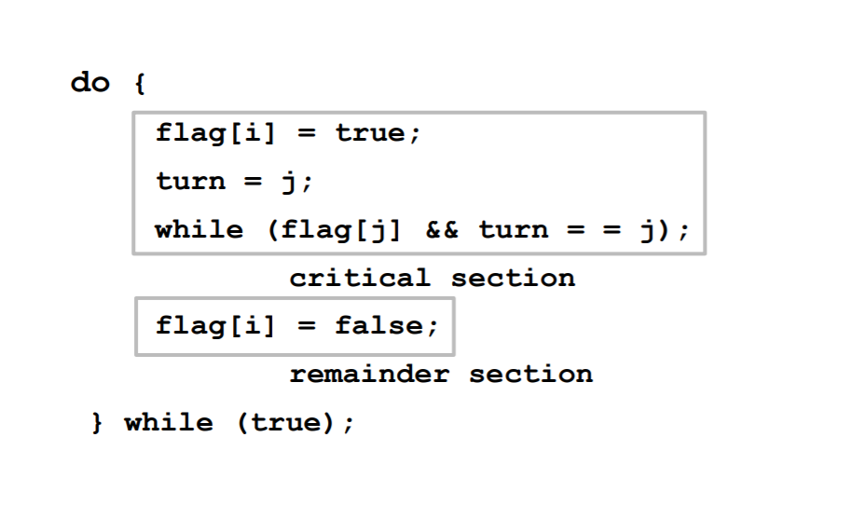
Peterson’s sol.. Algorithm
Peterson’s Algorithm

Slide 11
Explanation :
Peterson’s Algorithm is used to synchronize two processes.
In this algorithm , the variable i can be the (Process i) Producer and j can be Consumer (Process j).
Initially the flags are false.
When a particular process wants to enter its critical section, it sets it’s flag to true and turn as the index of the other process. This means that the process wants to execute but it will allow the other process to run first.
The process performs busy waiting until the other process has finished it’s own critical section.

Slide 12
Peterson’s sol. Contd..
The solution addresses all the 3 conditions required for solving a Critical section problem.
Mutual exclusion
Progress
Bounded waiting

Slide 13
Limitations of Peterson’s sol
Applicable only between processes
Busy waiting.

Slide 14
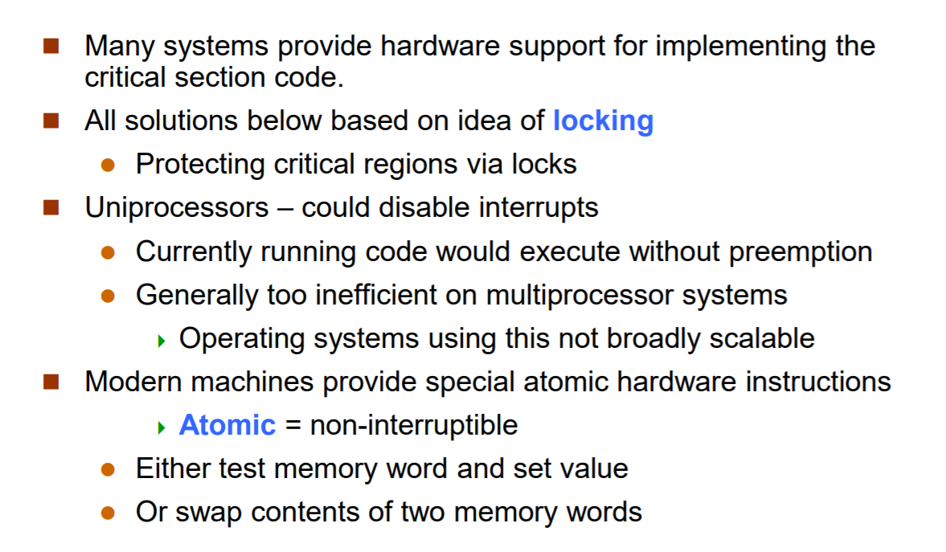
Hardware solution - Overview

Slide 15
Hardware sol..
Many modern computer systems therefore provide special hardware instructions that allow us either to test and modify the content of a word or to swap the contents of two words atomically— that is, as one uninterruptible unit (TSL/Compare and Swap Instruction).

Slide 16
Hardware solutions to CS problem (i) TSL (ii) Compare and swap

Slide 17
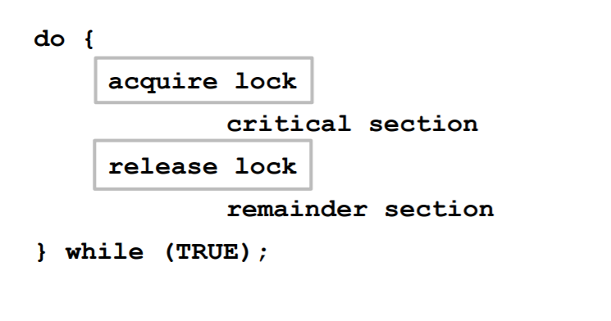
General Structure of a process using locks :

Slide 18
(i) Test and set lock (TSL)
This instruction reads the contents of a memory location, stores it in a register and then stores a non-zero value at the address.
This operation is guaranteed to be indivisible (TSL- atomic).
That is, no other process can access that memory location until the TSL instruction has finished.

Slide 19
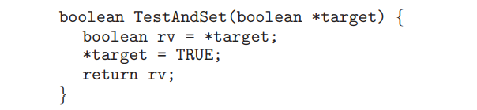
(i) TSL Instruction ( Test and Set Lock)
Defining the Test and Set Lock:

Slide 20
Test and Set Lock Instruction
If two TestAndSet() instructions are executed simultaneously (each on a different CPU), they will be executed sequentially in some arbitrary order.
If the machine supports the TestAndSet() instruction, then we can implement mutual exclusion by declaring a Boolean variable lock, initialized to false. The structure of a Process using TSL is presented as follows:

Slide 21
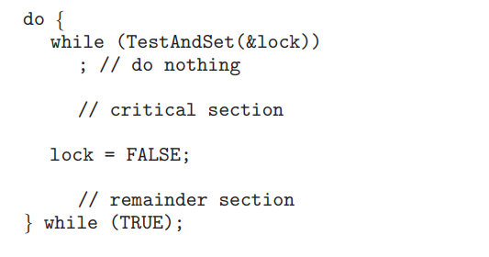
General structure of a process using Test and set lock (TSL)

Slide 22
(ii) Compare and swap
The Swap() instruction, in contrast to the TestAndSet() instruction, operates on the contents of two words.
Like the TestAndSet() instruction, it is executed atomically. If the machine supports the Swap() instruction, then mutual exclusion can be provided as follows:
A global Boolean variable lock is declared and is initialized to false. In addition, each process has a local Boolean variable key.
The structure of process Pi is given in the next slide.

Slide 23
(ii) Compare and swap Instruction
do { while (compare_and_swap(&lock, 0 , 1)!=0)
; /* do nothing */
/* critical section */
lock = 0;
/* remainder section */
} while (true);

Slide 24
Note:
Although mutual exclusion exclusion is guarenteed. Bounded waiting is not met in both Test and set Lock & Compare and swap methods. Hence, to fulfill all 3 conditions for the Critical section problem following improved version of TSL is introduced.

Slide 25
Data structures used.. (Improved version) TSL
boolean waiting[n];
boolean lock;
Initially all the variables are initialized to False.

Slide 26
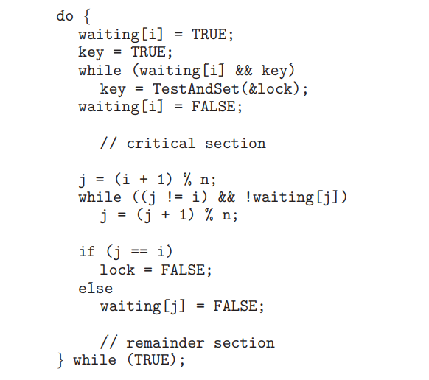
Bounded waiting Mutual exclusion with Test and set Lock

Slide 27
Explanation
These data structures are initialized to false.
To prove that the mutualexclusion requirement is met, we note that process Pi can enter its critical section only if either waiting[i] == false or key == false.
The value of key can become false only if the TestAndSet() is executed.
The first process to execute the TestAndSet() will find key == false; all others must wait.
The variable waiting[i] can become false only if another process leaves its critical section; only one waiting[i] is set to false, maintaining the mutual-exclusion requirement

Slide 28
Contd..
To prove that the progress requirement is met, we note that the arguments presented for mutual exclusion also apply here, since a process exiting the critical section either sets lock to false or sets waiting[j] to false.
Both allow a process that is waiting to enter its critical section to proceed.

Slide 29
Contd..
To prove that the bounded-waiting requirement is met, we note that, when a process leaves its critical section, it scans the array waiting in the cyclic ordering (i + 1, i + 2, ..., n − 1, 0, ..., i − 1).
It designates the first process in this ordering that is in the entry section (waiting[j] == true) as the next one to enter the critical section. Any process waiting to enter its critical section will thus do so within n − 1 turns.

Slide 30
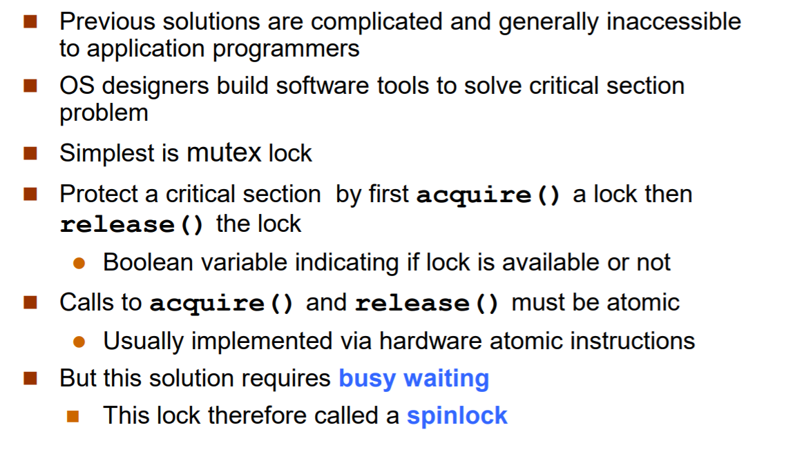
Mutex Locks

Slide 31
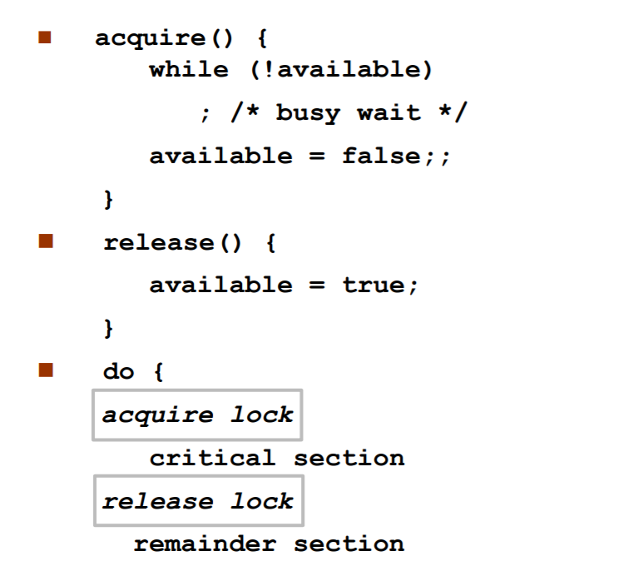
Mutex locks Contd..

Slide 32
Semaphores
Discovered by Dijkstra
Synchronization tool that does not require busy waiting
Semaphore or mutex variable S 🡪 integer variable
Two operations:
Wait()
Signal()
Less complicated

Slide 33
Semaphore – Contd…
General Structure of critical section using semaphores
do {
Wait(S)
critical section
Signal(S)
remainder section
} while (TRUE);
Definition-Wait
wait(S)
{
while(S<=0)
; //no-op
S--;
}
Definition-signal
Signal(S)
{
S++;
}

Slide 34
Operations on semaphores ( wait and signal / Down and Up)
Two operations:
block() – place the process in the waiting queue
wakeup() – remove one of the processes in the waiting queue and place it in the ready queue
wait(semaphore *S) {
S->value--;
if (S->value < 0) { add this process to S->list;
block();
}
}
signal(semaphore *S) {
S->value++;
if (S->value <= 0) { remove a process P from S->list;
wakeup(P);
}
}
Notes:
S->value is initialized to 0, therefore needs a call to signal() to provide one resource in order to start

Slide 35
Semaphore usage
Counting semaphore
Values are unrestricted
Binary semaphore
Values can range only between 0 and 1
We are using binary semaphores
Mutual Exclusion implementation with semaphores
do {
Wait(mutex)
critical section
Signal(mutex)
remainder section
} while (TRUE);

Slide 36
Example 1:
Semaphore is initialized with the number of resources available.
Semaphore is having 10 printers
Each process Pi, that needs the resource perform the wait() operation on semaphore [thereby decrementing the count]
When the process Pi, releases the resources, it performs signal() operation [incrementing the count value]
Count = 0 🡪 all resources are used
Count = n 🡪 all processes released the resources

Slide 37
Example 2:
Assume 2 concurrent running processes
P1 with statement S1;
P2 with statement S2;
s2 is executed after s1 has completed
P1 and p2 share a common semaphore
Synch = 0
S1;
Signal(synch);
wait(synch);
S2;
Fig. Statements in P1
Fig. Statements in P2

Slide 38
Disadvantages of semaphores
Busy waiting
(ie) when a process is in critical section, the other process loop indefinitely.
Wasting its time

Slide 39
Semaphore Implementation with no Busy Waiting
Two operations:
block() – place the process in the waiting queue
wakeup() – remove one of the processes in the waiting queue and place it in the ready queue
wait(semaphore *S) {
S->value--;
if (S->value < 0) { add this process to S->list;
block();
}
}
signal(semaphore *S) {
S->value++;
if (S->value <= 0) { remove a process P from S->list;
wakeup(P);
}
}
Notes:
S->value is initialized to 0, therefore needs a call to signal() to provide one resource in order to start

Slide 40
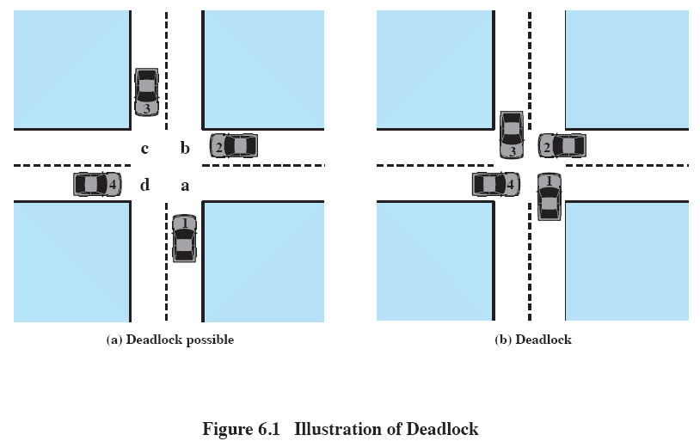
Deadlocks
Definition:
Two or more processes waiting indefinitely for an event to be completed is called as Deadlock.

Slide 41
Example
System has 2 tape drives.
P₁ and P₂ each hold one tape drive and each needs another one.
Consider 2 processes P0 and P1.
semaphores A and B, initialized to 1
P₀ P₁
wait (A); wait(B)
wait (B); wait(A)
signal(B); signal(A)
signal(A); signal(B)
P0 and P1 are deadlocked

Slide 42
Classical problems of Synchronization
Bounded-Buffer Producer/Consumer Problem
Readers and Writers Problem
Dining Philosophers Problem ( Monitor)

Slide 43
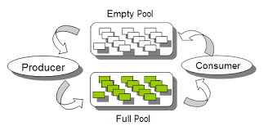
Bounded-Buffer Producer/Consumer Problem
Shared data: semaphore full, empty, mutex
Initially: full = 0, empty = n, mutex = 1
where n is the buffer size
Empty 🡪 Empty Buffer
Full 🡪 Full Buffer
Producer 🡪 make buffer full
Consumer 🡪 empty the buffer

Slide 44
Explanation
Consider a pool contains “n” buffers and each buffer can hold an item. The shared variable “mutex” provides the required mutual exclusion for the buffer pool, “empty” and “full” are semaphore variables used to count the number of empty and full buffers.
Need to initialize the mutex variable as ‘1’, empty=‘n’ and full=‘0’.
According to the production and consumption by the producer and the consumer, the variables empty and full will get modified.
With the help of “wait” and “signal” method of semaphores, the bounded buffer problem can be handled properly.

Slide 45
The structure of the
Producer process
The structure of the consumer process
do {
// produce an item in nextp
wait (empty);
wait (mutex);
// add the item to the buffer
signal (mutex);
signal (full);
} while (TRUE);
do {
wait (full);
wait (mutex);
// remove an item from buffer to nextc
signal (mutex);
signal (empty);
//consume the item in nextc
} while (TRUE);

Slide 46
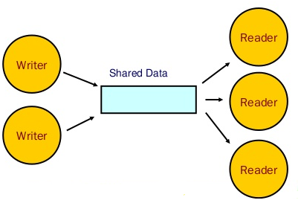
Readers-Writers Problem
A data set is shared among many processes
Readers – only read the data set; they do not perform any updates
Writers – can both read and write
Problem
Allow multiple readers to read at the same time
But Only one writer can write
Shared data: semaphore mutex, rw_mutex
Initially: mutex = 1, rw_mutex = 1,
int readcount =0

Slide 47
Explanation
Consider a situation of having concurrent read and write operation over a common resource like database. In which, many users wants to read and write on the same database. If many users are concurrently perform read operation, it will not create any problem. Whereas if a write operation and any other operation(may be read or write) are concurrently performed on the common field may leads to inconsistencies in the database content.
This synchronization problem is called as “reader-writers” problem. The order in which the read and write operation performed may leads to starvation if they are not synchronized properly.

Slide 48
The structure of the
Reader process
The structure of the
Writer process
do {
wait (mutex) ;
readcount ++ ;
if (readcount == 1)
wait (rw_mutex) ;
signal (mutex)
//reading is performed
wait (mutex) ;
readcount - - ;
if (readcount == 0)
signal (rw_mutex) ;
signal (mutex) ;
} while (TRUE);
do {
wait (rw_mutex) ;
// writing is performed
signal (rw_mutex) ;
} while (TRUE);
Notes:
https://www.geeksforgeeks.org/readers-writers-problem-set-1-introduction-and-readers-preference-solution/

Slide 49
The structure of reader and writer process is given in the above figure.
“rw_mutex” semaphore variable is shared among readers and writer processes.
“rw_mutex” act as a mutual exclusion semaphore for writer processes.
“read_count” variable get updated whenever a new reader process will come or when it gets completed.
“read_count” will specify the number of current read processes waiting for the resource.
With the help of “wait” and “signal” methods of semaphore, the synchronization between readers and writers processes can be achieved.

Slide 50

Dining-Philosophers Problem
Five philosophers spend their lives thinking and eating
Circular table with 5 chairs, 5 philosophers, 5 plates and 5 chopsticks
Each philosopher need 2 chopsticks to eat. After eating, they drop chopsticks
One person cannot pickup chopstick (ie) already in hand of a neighbour
Shared data
Bowl of rice (data set)
Semaphore chopstick [5] initialized to 1

Slide 51
The structure of the Philosopher
do {
wait ( chopstick[i] );
wait ( chopStick[ (i + 1) % 5] );
// eat
signal ( chopstick[i] );
signal (chopstick[ (i + 1) % 5] );
// think
} while (TRUE);

Slide 52
To avoid deadlock in Dining Philosopher problem
At most 4 philosophers to sit simultaneously
Allow philosophers to pick chopsticks, only when both chopsticks are available
Use an asymmetric solution
Odd philosopher picks up left chopstick first
Even philosopher picks up right chopstick

Slide 53
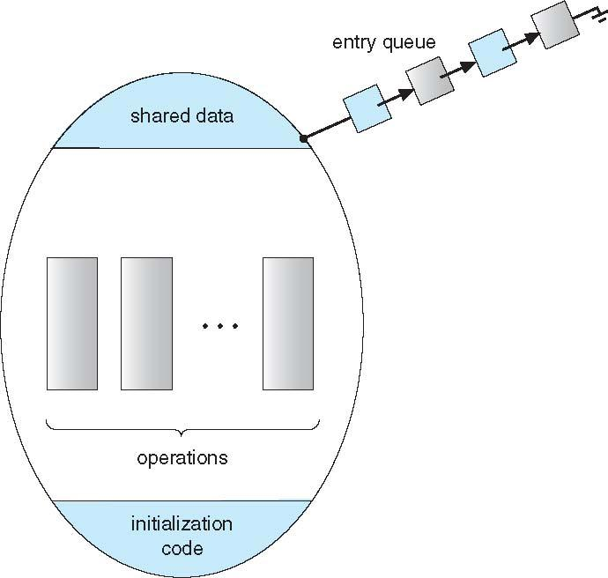
Monitors
Monitor is Abstract data type, where the internal variables only accessible by code within the procedure
Programming languages like PASCAL, C# implement the concept of monitor
Only one process is active within the monitor at a time
Not powerful

Slide 54
Variables & Operations
Two variables of data type condition is used
condition x, y;
Two operations
x.wait ()
A process that invokes the operation until x.signal ()
x.signal ()
Resumes one of processes that invoked x.wait ()

Slide 55
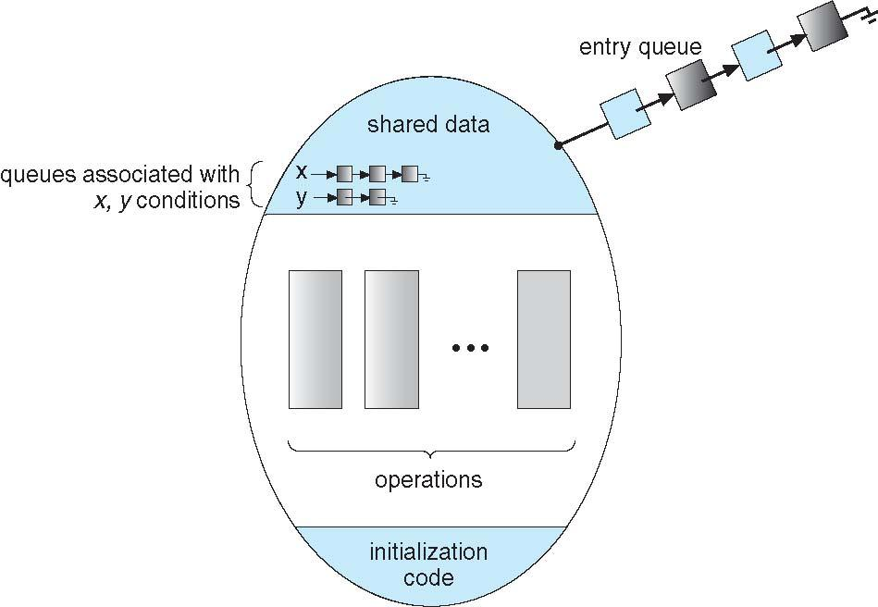
Monitor with Condition Variables

Slide 56
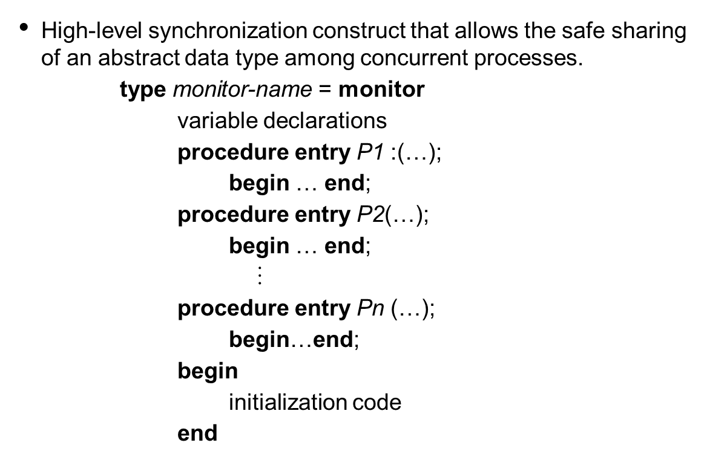
Monitor (syntax)

Slide 57
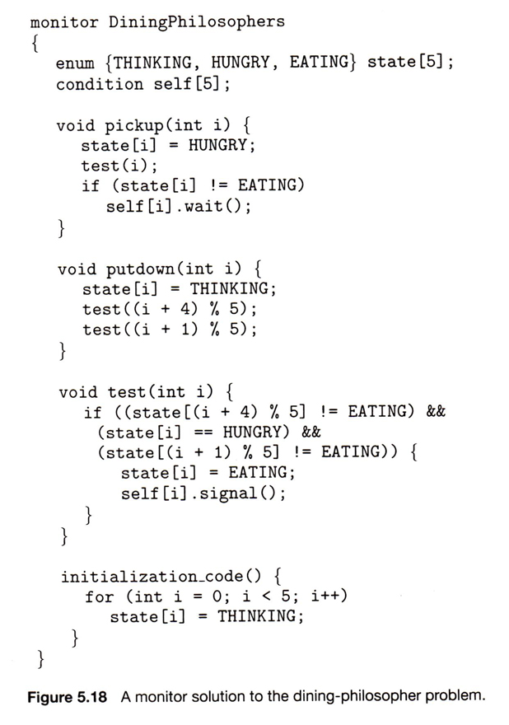
Monitor solution for Dining Philosopher problem

Slide 58
General structure of a Philosopher i using Pickup() and Putdown()
Syntax:
DiningPhilosophers.pickup(i);
...
eat
...
DiningPhilosophers.putdown(i);
Note : This solution ensures that no two neighbors are eating simultaneously and that no deadlocks will occur.

Slide 59

PROCESS SCHEDULING

Slide 60
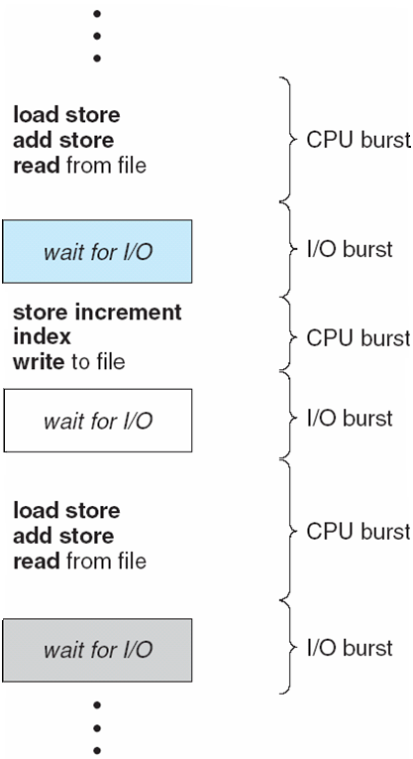
Basic Concepts
Maximum CPU utilization is obtained with multiprogramming
Process execution consists of a cycle of a CPU time burst and an I/O time burst
Processes alternate between these two states (i.e., CPU burst and I/O burst)
Eventually, the final CPU burst ends with terminate execution

Slide 61
Preemptive:
The CPU is allocated to the process, if any higher priority process come it releases the CPU and get the service once the higher priority process completes.
Non Preemptive:
Once the CPU is allocated to the process, the process keeps the CPU until it releases the CPU either by terminating or switching to waiting state.

Slide 62
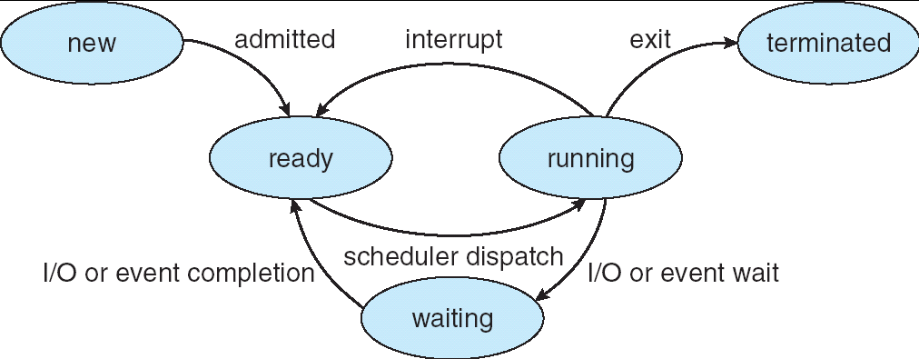
CPU Scheduler
The CPU scheduler selects from among the processes in memory that are ready to execute and allocates the CPU to one of them
Ready Queue 🡪 CPU
When CPU scheduling takes place?
1. (N) A process switches from running to waiting state
2. (P) A process switches from running to ready state
3. (P) A process switches from waiting to ready state
4. (N) A processes switches from running to terminated state
Circumstances 1 and 4 are non-preemptive
Circumstances 2 and 3 are pre-emptive

Slide 63
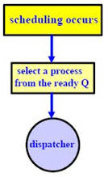
Dispatcher
The dispatcher module gives control of the CPU to the process selected by the short-term scheduler; this involves:
switching context
switching to user mode
jumping to the proper location in the user program to restart that program
The time it takes for the dispatcher to stop one process and start another process is called dispatch latency

Slide 64
Scheduling Criteria
Different CPU scheduling algorithms have different properties
CPU utilization – keep CPU as busy as possible
CPU utilization ranges from 0% to 100%
Lightly loaded system 🡪 40%
Heavily loaded system 🡪 90%
Throughput = Number of processes completed /Unit time
Response time – amount of time it takes from when a request was submitted until the first response occurs
Waiting time – the amount of time the processes has been waiting in the ready queue
Turnaround time – amount of time to execute a particular process from the time of submission through the time of completion

Slide 65
Scheduling Algorithms
First-Come, First-Served (FCFS) Scheduling
Shortest-Job-First (SJF) Scheduling
Simultaneous arrival times
Varied arrival times
Preemptive SJF with varied arrival times = Shortest-remaining time First (SRT) Scheduling
Priority Scheduling
Preemptive & non preemptive
Round robin scheduling
Multi-level Queue Scheduling
Multilevel Feedback Queue Scheduling

Slide 66
First-Come, First-Served (FCFS) Scheduling
The first entered job is the first one to be serviced.
Example: Three processes arrive in order P1, P2, P3.
P1 burst time: 24
P2 burst time: 3
P3 burst time: 3
Draw the Gantt Chart and compute Average Waiting Time and Average Completion Time.

Slide 67
First-Come, First-Served (FCFS)
Example: Three processes arrive in order P1, P2, P3.
P1 burst time: 24
P2 burst time: 3
P3 burst time: 3
Waiting Time
P1: 0
P2: 24
P3: 27
Completion Time
P1: 24
P2: 27
P3: 30
Average Waiting Time: (0+24+27)/3 = 17
Average Turnaround time: (24+27+30)/3 =27
Convoy effect (2 mark)
All the other processes wait for one long process to finish its execution
P1
P2
P3
0
24
27
30

Slide 68
First-Come, First-Served (FCFS)
What if their order had been P2, P3, P1?
P1 burst time: 24
P2 burst time: 3
P3 burst time: 3

Slide 69
First-Come, First-Served (FCFS)
What if their order had been P2, P3, P1?
P1 burst time: 24
P2 burst time: 3
P3 burst time: 3
Waiting Time
P2: 0
P3: 3
P1: 6
Turn-around Time
P2: 3
P3: 6
P1: 30
Average Waiting Time: (0+3+6)/3 = 3 (compared to 17)
Average turn-around Time: (3+6+30)/3 = 13 (compared to 27)
P2
P3
P1
0
3
6
30
Gnatt Chart

Slide 70
FIFO (First In and First Out) or FCFS
Advantages:
Simple
Disadvantages:
Short jobs get stuck behind long ones
There is no option for pre-emption of a process. If a process is started, then CPU executes the process until it ends.
Because there is no pre-emption, if a process executes for a long time, the processes in the back of the queue will have to wait for a long time before they get a chance to be executed.

Slide 71
Shortest-Job-First (SJF) Scheduling (simultaneous arrival ie. all jobs arrive at the same time)
Example 1
P1 burst time: 24
P2 burst time: 3
P3 burst time: 3
Waiting Time
P2: 0
P3: 3
P1: 6
Turn-around Time
P2: 3
P3: 6
P1: 30
Average Waiting Time: (0+3+6)/3 = 3
Average turn-around Time: (3+6+30)/3 = 13
P2
P3
P1
0
3
6
30
Gnatt Chart

Slide 72
Shortest-Job-First (SJF) Scheduling Here come the concept of arrival time. SJF (non-preemptive, varied arrival times)
Example 2
Process Arrival Time Burst Time
P₁ 0 7
P₂ 2 4
P₃ 4 1
P₄ 5 4
Average waiting time = ( (0 – 0) + (8 – 2) + (7 – 4) + (12 – 5) )/4 = (0 + 6 + 3 + 7)/4 = 4
Average turn-around time: = ( (7 – 0) + (12 – 2) + (8 - 4) + (16 – 5))/4 = ( 7 + 10 + 4 + 11)/4 = 8
P₁
P₃
P₂
P₄
Gnatt Chart
0
3
7
8
12
16
Waiting time : sum of time that a process has spent waiting in the ready queue

Slide 73
Shortest-remaining time First (SRT) Scheduling Preemptive SJF with varied arrival times
Example 3
Process Arrival Time Burst Time
P₁ 0.0 7
P₂ 2.0 4
P₃ 4.0 1
P₄ 5.0 4
Average waiting time
= ( [(0 – 0) + (11 - 2)] + [(2 – 2) + (5 – 4)] + (4 - 4) +
(7 – 5) )/4 = 9 + 1 + 0 + 2)/4
= 3
Average turn-around time = (16-0) + (7-2) + (5-4) + 11-4)/4 = 7
P₁
P₂
P₃
P₂
P₄
P₁
Gnatt Chart
0
2
4
5
7
11
16

Slide 74
Shortest-Job-First (SJF) Scheduling Pros and Cons
Advantages:
Works based on the next process CPU burst
It gives optimal waiting time
Disadvantages:
Long jobs get stuck behind short ones

Slide 75
Priority Scheduling
A priority number (integer) is associated with each process
The CPU is allocated to the process with the highest priority (smallest integer ≡ highest priority)
Preemptive
Nonpreemptive
SJF is priority scheduling where priority is the inverse of predicted next CPU burst time
Problem ≡ Starvation – low priority processes may never execute
Solution ≡ Aging – as time progresses increase the priority of the process

Slide 76
Priority Scheduling (non –Preemptive)
A priority number (integer) is associated with each process
(smallest integer = highest priority)
Process
A
B
C
Burst Time
8
1
1
Priority
2
1
3
B
A
C
0
1
9
10
Gnatt Chart
Avg Wait Time (0 + 1 + 9) / 3 = 3.3

Slide 77
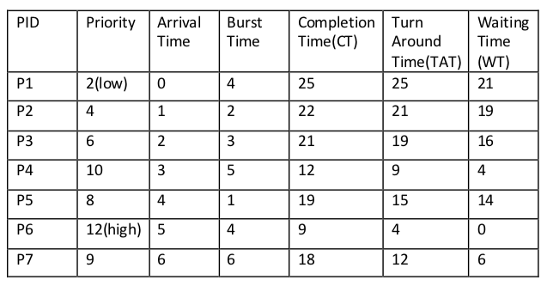
Priority Scheduling (Preemptive)
Consider the example with seven process.

Slide 78
Gantt chart
Average waiting time
Starvation
It is a situation in which the continuous arrival of higher priority process keeps the lowest priority process always in waiting state. The waiting process will starve (in other words, the deadline of the waiting process will never meet). We can resolve the starvation problem in the priority scheduling with the help of Aging technique.
Aging Technique
In Aging technique, the priority of every lower priority processes has to be increased after a fixed interval of time.

Slide 79
Priority Scheduling Pros and Cons
Advantages:
Higher priority job executes first
Disadvantages:
Starvation ie. low priority processes never execute.
To overcome the above problem “AGING” 🡪 the priority of a process is increased

Slide 80
Round Robin (RR) Scheduling
In the round robin algorithm, each process gets a small unit of CPU time (a time quantum), usually 10-100 ms.
After this time has elapsed, the process is preempted and added to the end of the ready queue.
Performance of the round robin algorithm
q large ⇒ FCFS
q small ⇒ q must be greater than the context switch time; otherwise, the overhead is too high

Slide 81
Example of RR with Time Quantum = 4
Example 1
Process Burst Time
P₁ 24
P₂ 3
P₃ 3
The Gantt chart is:
P₁
P₂
P₃
P₁
P₁
P₁
P₁
P₁
0
4
7
10
14
18
22
26
30
Average turn around time is larger than SJF
But more context switching
Average waiting time =(6+4+7)/3 = 5.6 ms

Slide 82
Example of RR with Time Quantum = 20
Process Burst Time
P₁ 53
P₂ 17
P₃ 68
P₄ 24
Gantt chart is:
Average waiting time = ( [(0 – 0) + (77 - 20) + (121 – 97)] + (20 – 0) + [(37 – 0) + (97 - 57) +
(134 – 117)] + [(57 – 0) + (117 – 77)] ) / 4 = (0 + 57 + 24) + 20 + (37 + 40 + 17) + (57 + 40) ) / 4 = (81 + 20 + 94 + 97)/4 = 292 / 4 = 73
Average turn-around time = (134 + 37 + 162 + 121) / 4 = 113.5
Example 2
P₁
P₂
P₃
P₄
P₁
P₃
P₄
P₁
P₃
P₃
0
20
37
57
77
97
117
121
134
154
162

Slide 83
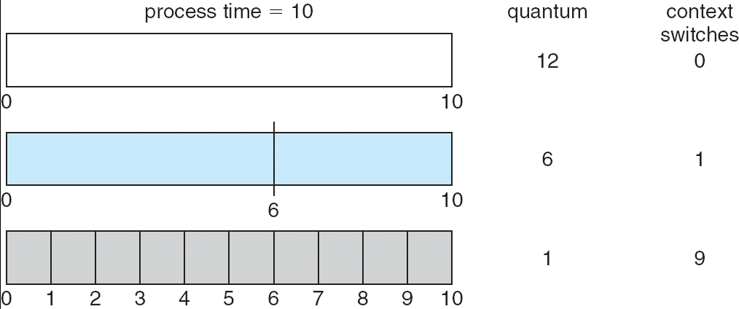
Time Quantum and Context Switches

Slide 84
Round Robin (RR) Scheduling Pros and Cons
Advantages:
Fair for smaller tasks
Disadvantages:
More context switching

Slide 85
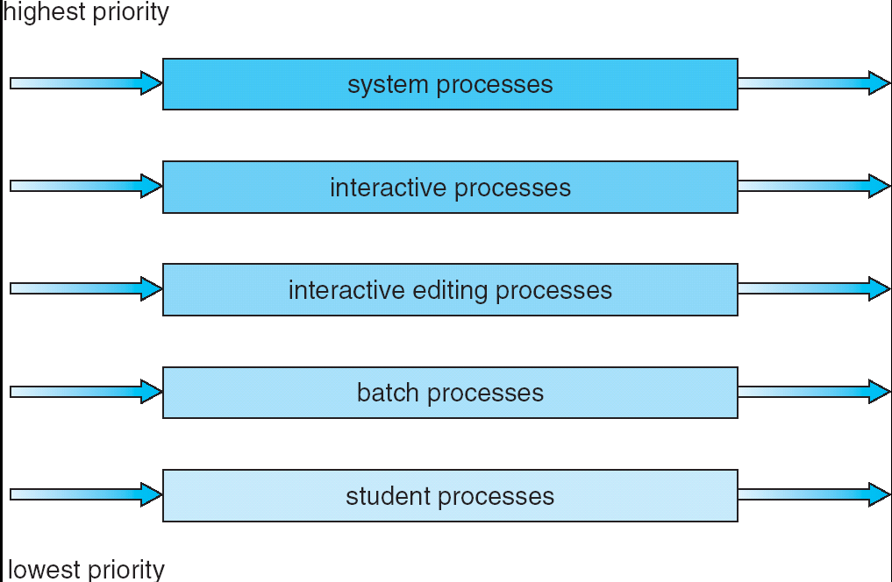
Multi-level Queue Scheduling
Multi-level queue scheduling is used when processes can be classified into groups
For example, foreground (interactive) processes and background (batch) processes
80% of the CPU time to foreground queue using RR.
20% of the CPU time to background queue using FCFS

Slide 86
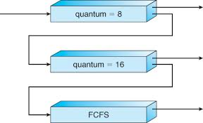
Multilevel Feedback Queue Scheduling
In multi-level feedback queue scheduling, a process can move between the various queues;
A new job enters queue Q₀ (RR) and is placed at the end. When it gains the CPU, the job receives 8 milliseconds. If it does not finish in 8 milliseconds, the job is moved to the end of queue Q₁.
A Q₁ (RR) job receives 16 milliseconds. If it still does not complete, it is preempted and moved to queue Q₂ (FCFS).
Q₀
Q₁
Q₂

Slide 87
Real-Time CPU Scheduling
CPU scheduling for real-time operating systems involves special issues.
In general, we can distinguish between soft real-time systems and hard real-time systems.
Soft real-time systems provide no guarantee as to when a critical real-time process will be scheduled. They guarantee only that the process will be given preference over noncritical processes.
Hard real-time systems have stricter requirements. A task must be serviced by its deadline; service after the deadline has expired is the same as no service at all.
In this section, we explore several issues related to process scheduling in both soft and hard real-time operating systems

Slide 88
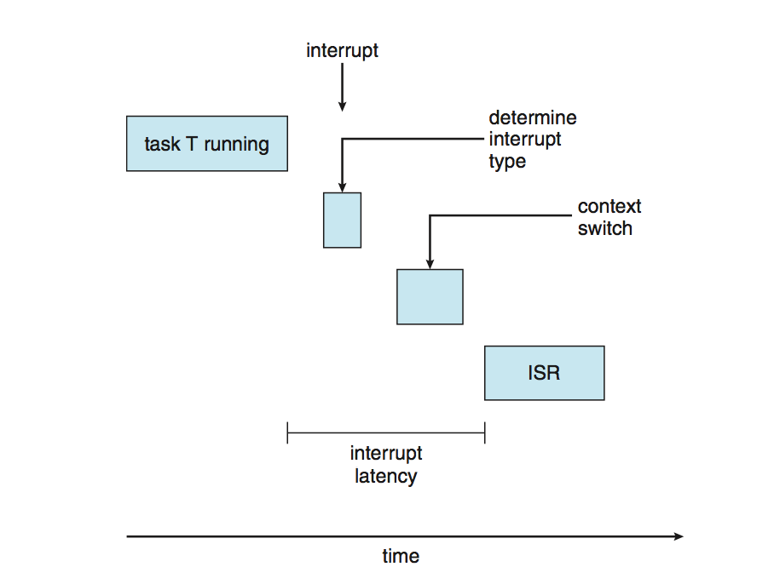
Real-Time CPU Scheduling
Two types of latencies affect performance
Interrupt latency – time from arrival of interrupt to start of routine that services interrupt
Dispatch latency – time for schedule to take current process off CPU and switch to another

Slide 89
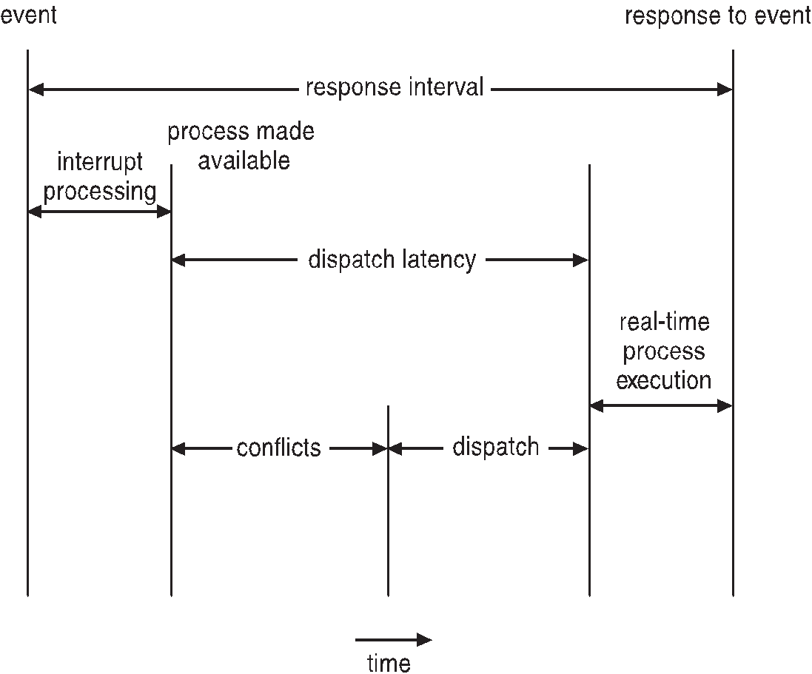
Real-Time CPU Scheduling (Cont.)
Conflict phase of dispatch latency:
Preemption of any process running in kernel mode
Release by low-priority process of resources needed by high-priority processes

Slide 90
Priority-based Scheduling
The most important feature of a real-time operating system is to respond immediately to a real-time process as soon as that process requires the CPU.
As a result the scheduler for a real-time operating system must support a priority-based algorithm with preemption.
Recall that priority-based scheduling algorithm assign each process a priority based on its importance; more are assigned higher priorities than those deemed less important.
If the scheduler also supports preemption, a process currently running on the CPU will preempted if a higher-priority process becomes available to run.

Slide 91
Priority-based Scheduling
Before we proceed with the details of the individual schedulers, how we must define certain characteristics of the processes that are to be scheduled.
Periodic processes require the CPU at specified intervals (periods).
p is the duration of the period.
d is the deadline by when the process must be serviced.
t is the processing time.
The relationship of the processing time, the deadline, and the period can be expressed as 0 ≤ t ≤ d ≤ p.

Slide 92
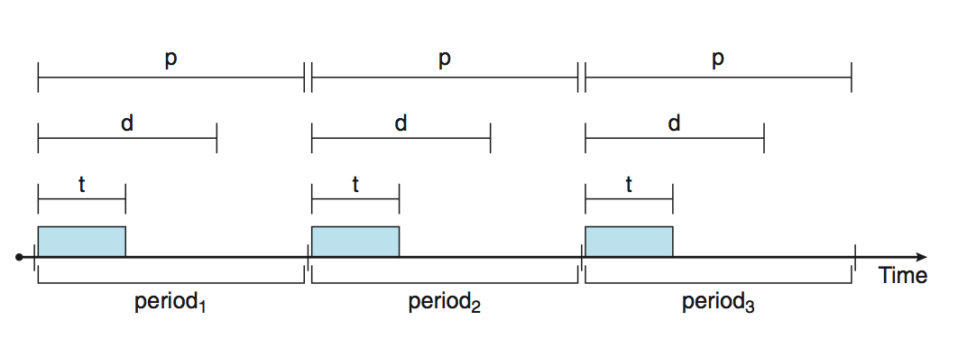
Priority-based Scheduling

Slide 93
Rate Monotonic Scheduling
The rate-monotonic scheduling algorithm schedules periodic tasks using static priority policy with preemption.
If a lower-priority process is running and a higher-priority process becomes available to run, it will preempt the lower priority process.
Upon entering the system, each periodic tasks and Priority inversely based on its period.
Shorter periods = higher priority;
Longer periods = lower priority
The rationale behind this policy is to assign a higher priority to tasks that require the CPU more often.
Furthermore, rate-monotonic scheduling assumes that the processing time of A periodic process is the same for each CPU burst. That is, every time a process acquires the CPU, the duration of its CPU burst is the same

Slide 94
Rate Monotonic Scheduling
Let's consider an example. We have two processes, P1 and P2.
The periods for P1 and P2 are p1=50, p2=100. The processing times are t1=20, t2=35.
The deadline for each it complete its CPU burst by the start of its next period.
We must ask ourselves whether it is possible to schedule these tasks so that each meets its deadlines.
If we measure the CPU utilization of a process Pi as the ratio of its burst to its period ti/pi.
The CPU utilization of P1 is 20/50=0.40 and that P2 is 35/100 = 0.35, for a total CPU utilization of 75percent.
Therefore, it seems we can schedule these tasks in such a way that both meet their deadlines and still leave the CPU with available cycles.

Slide 95
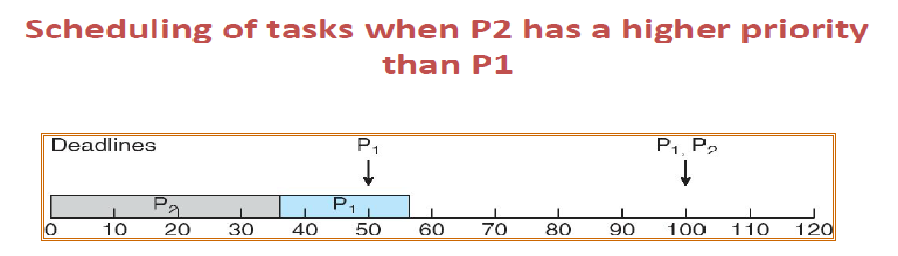
Rate Monotonic Scheduling
Example(Why not Priority scheduling)
Suppose we assign P2 a higher priority than P1.
The execution of P1 and P2 in this situation is shown in the below Figure.
As we can see, P2 starts execution first and completes at time 35.
At this point, P1 starts; it completes its CPU burst at time 55.
However, the first deadline for P1 was at time 50, so the scheduler has caused P1 to miss its deadline.

Slide 96
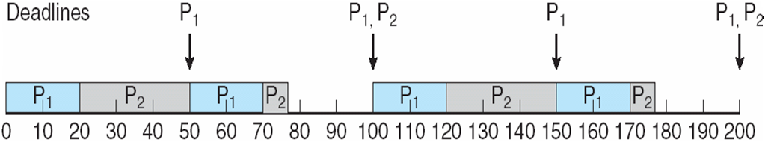
Rate Monotonic Scheduling
Now suppose we use rate-monotonic scheduling, in which we assign P1 a higher priority than P2 because the period of P1 is shorter than that of P2.
The execution of these processes in this situation is shown in the below Figure.
P1 starts first and completes its CPU burst at time 20, thereby meeting its first deadline.
P2 starts running at this point and runs until time 50.
At this time, it is preempted by P1, although it still has 5 milliseconds remaining in its CPU burst.
P1 completes its CPU burst at time 70, at which point the scheduler resumes P2.

Slide 97
Missed Deadlines with Rate Monotonic Scheduling
Let's next examine a set of processes that cannot be scheduled using the rate Monotonic algorithm.
Assume that process P1 has a period of p1 = 50 and a CPU burst of t1=25.
For P2, the corresponding values are p2= 80 and t2= 35.
Rate-monotonic scheduling would assign process P1 a higher priority as it has the shorter period.
The total CPU utilization of the two processes is (25/50)+(35/80)=0.94, and it therefore seems logical that the two processes could be scheduled an leave the CPU with 6 percent available time.

Slide 98
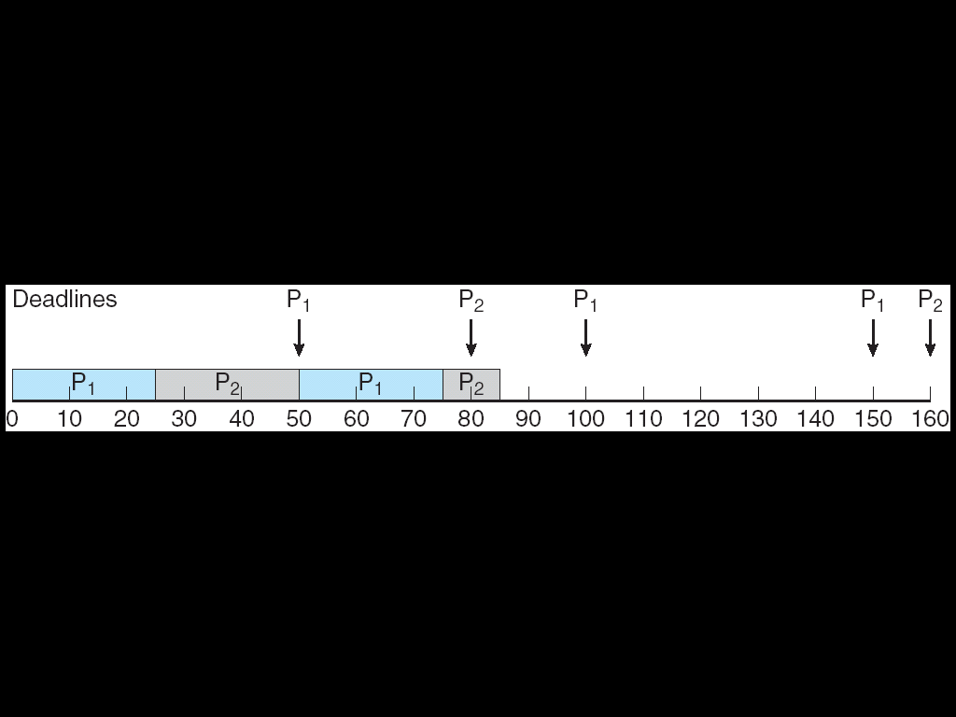
Missed Deadlines with Rate Monotonic Scheduling
Below figure shows the scheduling processes P1 and P2. Initially P1, runs until it completes its CPU burst at time 25.
Process P2 then begins running and runs until time 50, when it is preempted by P1.
At this point, P2, still has 10 milliseconds remaining in its CPU burst. Process P1 runs until time 75; consequently, P2 finishes its burst at time 85, after the deadline for completion of its CPU burst at time 80.
p1=50, p2=80 t1=25, t2=35

Slide 99
Earliest Deadline First Scheduling (EDF)
Earliest-deadline-first (EDF) scheduling dynamically assigns priorities according to deadline.
The earlier the deadline, the higher the priority; the later the deadline, the lower the priority.
Under the EDF policy, when a process becomes runnable, it must announce its deadline requirements to the system. Priorities may have to be adjusted to reflect the deadline of the newly runnable process.
Note how this differs from rate-monotonic scheduling, where priorities are fixed.
To illustrate EDF scheduling, we again schedule the processes which failed to meet deadline requirement under the rate-monotonic scheduling.

Slide 100
Earliest Deadline First Scheduling (EDF)
Recall that P1 has values of p1=50 and t1=25 and that values of p2 = 80 and t2= 35.
The EDF scheduling of these processes in below figure. Process P1 has the earliest deadline, so its initial priority is higher than that of process P2.
Process P2 begins running at the end of the CPU burst for P1. However, whereas rate-monotonic scheduling allows P1 to preempt P2 at the beginning of its next period at time 50, EDF scheduling allows process P2 to continue running.
P2 now has a higher priority than P1, because its next deadline (at time 80) is earlier than that of P1 (at time 100).
Thus, both P1 and P2 meet their first deadlines. Process P1 again begins running, at time 60 and completes its second CPU burst at time 85, also meeting its second deadline at time 100.
P2 begins running at this point, only to be preempted by P1 at the start of its next period at time 100. P2 is preempted because P1 has an earlier deadline (time 150) than P2(time 160).
At time 125, P1 completes its CPU burst and P2 resumes execution, finishing at time 145 and meeting its deadline a well.
The system is idle until time 150, when P1 is scheduled to run once again.

Slide 101
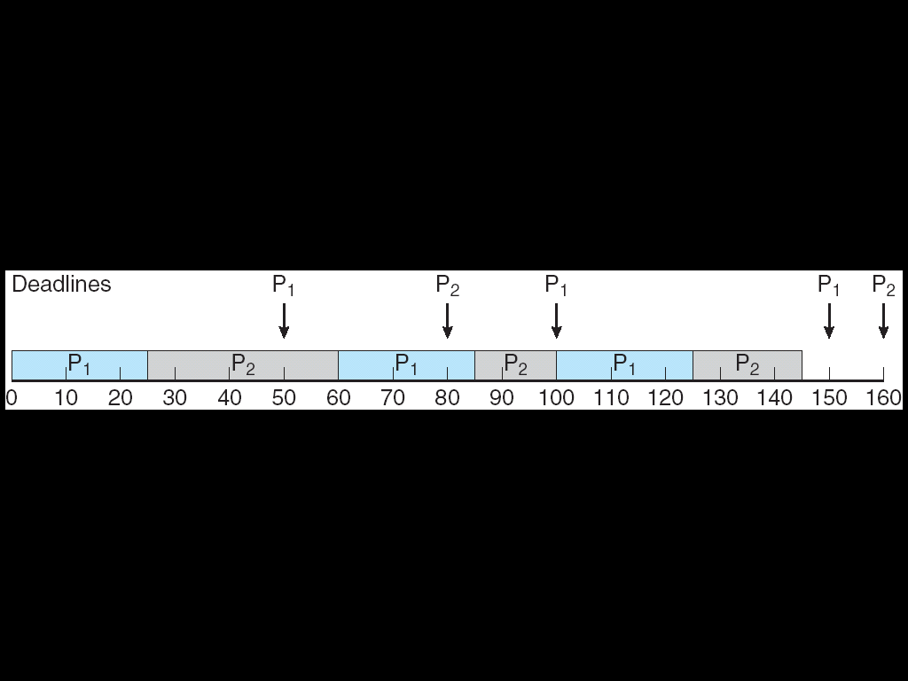
Earliest Deadline First Scheduling (EDF)
Unlike the rate-monotonic algorithm, EDF scheduling does not require that processes be periodic, nor must a process require a constant amount of CPU time per burst.
The only requirement is that a process announce its deadline to the scheduler when it becomes runnable.
The appeal of EDF scheduling is that it is theoretically optimal -- theoretically, it can schedule processes so that each process can meet its deadline requirements and CPU utilization will be 100 percent.
In practice, however, it is impossible to achieve this level of CPU utilization due to the cost of context switching between processes and interrupt handling.

Slide 102
Deadlocks

Slide 103
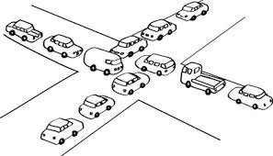
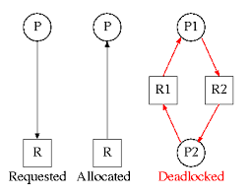
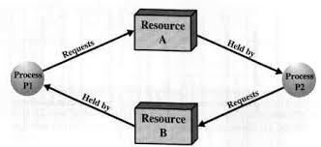
Deadlocks
Assume 2 process, P1 and p2.
When p1 process is holding resource R1 and requesting for resource R2, where it is hold by process P2. This state is DEADLOCK.

Slide 104
System Model
Assume resource types R₁, R₂, . . ., R_{m}
CPU cycles, memory space, I/O devices
Each resource type R_{i} has 1 or more instances
Each process utilizes a resource as follows:
Request
The process requests the resource.
If (resource == available)
Grant the resource
else
Wait
Use
The process use the resource
Release
The process release the resource

Slide 105
Deadlock Characterization Repeated University Question
Deadlock can arise if four conditions hold simultaneously.
Mutual exclusion:
Only one process at a time can use a resource. If another process requests, they need to wait.
Hold and wait:
A process holding at least one resource is waiting to acquire additional resources which is held by other processes
No preemption:
A resource can be released only voluntarily by the process holding it after that process has completed its task
Circular wait:
There exists a set {P₀, P₁, …, P₀} of waiting processes
P₀ is waiting for a resource that is held by P₁
P₁ is waiting for a resource that is held by P₂
P_{n–1} is waiting for a resource that is held by P_{n}
P_{n} is waiting for a resource that is held by P₀
P₀
P₁
P_{n-1}
P_{n}

Slide 106
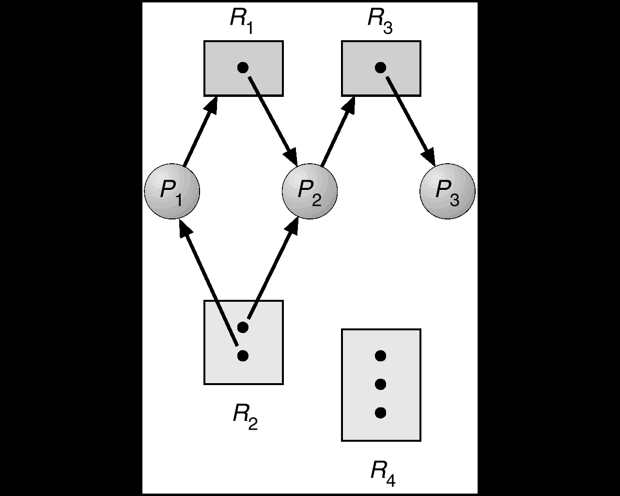
Resource-Allocation Graph
Deadlocks are described in terms of directed graph called Resource Allocation Graph.
Graph consists of a set of vertices V and a set of edges E.
Request edge:
It is a directed edge from P₁ to resource type R_{j}
P₁ → R_{j}
Assignment edge:
It is a directed edge from R_{j}
to resource type P₁
R_{j} → P₁
R3 Assigned to P3
P2 Requests R3
Note:
If resource type has more than 1 instance, its indicated by a dot within the rectangle.

Slide 107
Details
The resource allocation graph consists of following sets:
P ={ P1,P2,p3}
R ={ R1, R2, R3, R4}
E = { p1 🡪 R1, P2 🡪 R3, R1 🡪 P2,
R2🡪 P2, R2🡪P1, R3🡪 P3}
P = Process; R = Resources; E = Edges.
Resource Instance
One instance of resource type R1
Two instance of resource type R2
One instance of resource type R3
Three instance of resource type R4

Slide 108
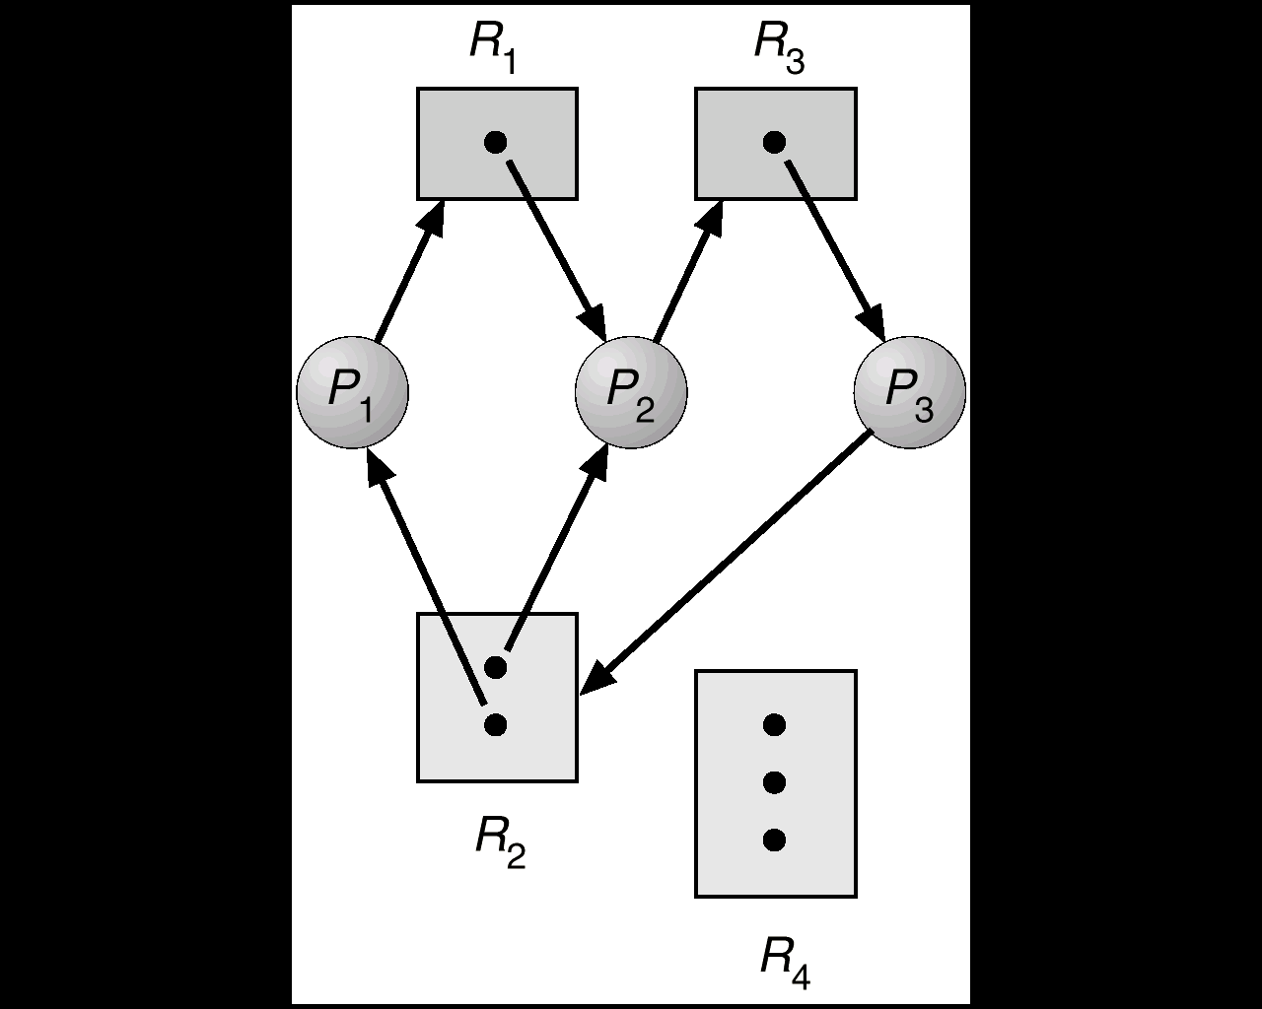
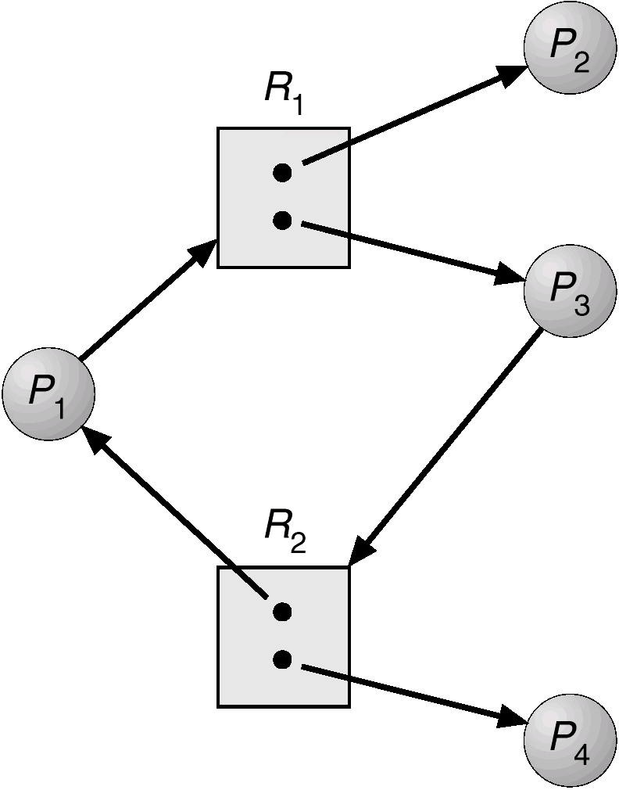
Examples
Resource allocation graph
with a deadlock.
Resource allocation graph
with a cycle but no deadlock.

Slide 109
HOW TO HANDLE DEADLOCKS ? (or)
Methods for handling deadlocks.
There are three methods:
Ignore Deadlocks:
Ensure deadlock never occurs using either
Prevention :
Prevent any one of the 4 conditions never happens.
Avoidance :
Allow all deadlock conditions, but calculate cycles and stop dangerous operations..
Allow deadlock to happen. This requires using both:
Detection Know a deadlock has occurred.
Recovery Regain the resources.
1
Most Operating systems do this!!
2
3

Slide 110
Deadlock Prevention
Do not allow one of the four conditions to occur.
Mutual exclusion:
Read only files are good examples for sharable resource
Any number of users can access the file at the same time.
Prevention not possible, since some devices like are non-sharable.
Hold and wait:
Collect all resources before execution
A sequence of resources is always collected at the beginning itself.
Utilization is low, starvation possible.

Slide 111
Deadlock Prevention – Contd…
No preemption:
If the process is holding some resources and requests another resource (that cannot be immediately allocated to it), then all the resources that the process currently holding are preempted.
Circular wait:
R = { R1,R2…Rm} 🡪 set all resource types.
We define a function,
For example: F(tape drive) = 1 F(disk drive) = 5 F(printer) = 12
Each process requests resources in an increasing order of enumeration (ie) F(R_{j}) > F(R_{i})
F: R 🡪 N
N = natural number

Slide 112
Deadlock Avoidance
When we try to avoid deadlock
Utilization is less and system throughput is low
An alternative method for avoiding deadlocks is to require additional information about how much resources are to be requested.

Slide 113
Safe State
NOTE: All deadlocks are unsafe, but all unsafes are NOT deadlocks.
SAFE
UNSAFE
DEADLOCK
Only with luck, the processes avoid deadlock.
OS can avoid
deadlock.

Slide 114
Safe State
A system is said to be in safe state, when we allocate resources so that deadlock never occurs.
A system is in safe state, only if there exists safe sequence.

Slide 115
Deadlock Avoidance - Example
EXAMPLE:
There exists a total of 12 resources and 3 processes.
Process | Max Needs | Allocated | Current Needs
P0 | 10 | 5 | 5
P1 | 4 | 2 | 2
P2 | 7 | 3 | 4
At time t0 , system is in safe state
At time t1, < p1, p2, p0 > is a safe sequence.
Suppose p2 requests and is given one more resource. What happens then?

Slide 116
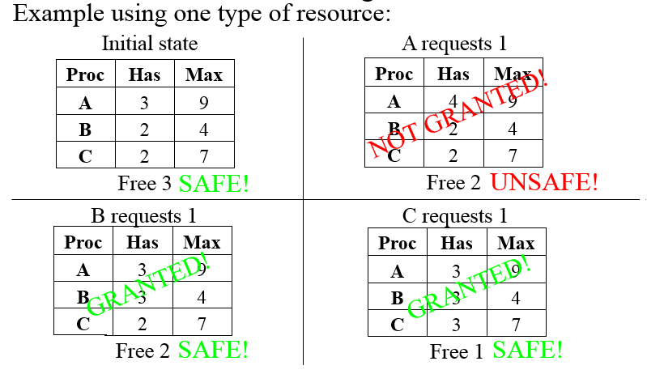
Examples

Slide 117
Avoidance algorithms
For a single instance of a resource type, use a Resource-allocation Graph
For multiple instances of a resource type, use the Banker’s Algorithm

Slide 118
Resource-Allocation Graph
Introduce a new kind of edge called a Claim Edge Claim edge P_{i} R_{j} indicates that process P_{j} may request resource R_{j}; which is represented by a dashed line.
A claim edge converts to a request edge when a process requests a resource
A request edge converts to an assignment edge when the resource is allocated to the process
When a resource is released by a process, an assignment edge reconverts to a claim edge.
Claim Edge
Can be converted to
Request Edge
Can be converted to
Assignment Edge
Can be converted to

Slide 119
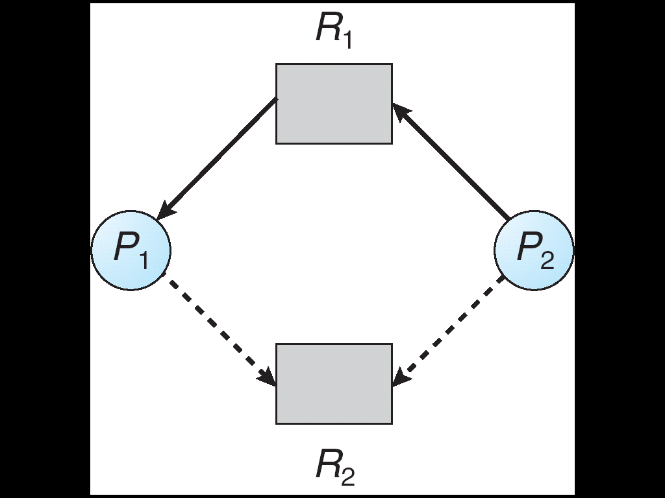
Resource-Allocation Graph with Claim Edges
Unsafe State In Resource-Allocation Graph
Assignment
edge
Request
edge
Claim
edge
Claim
edge
Assignment
edge
Request
edge
Claim
edge
Assignment
edge

Slide 120
Banker’s Algorithm
Applicable for multiple instances of a resource type.
Its less efficient than Resource-Allocation Graph
When a process requests a resource, the system determines whether the allocation of resources will lead to safe state.
If it lead to safe state 🡪 allocate resources
If not safe state 🡪 don’t allocate resources

Slide 121
Data Structures for the Banker’s Algorithm
Let n = number of processes, and m = number of resources types.
Available: Vector of length m. If Available [j] = k, there are k instances of resource type R_{j} available.
Max: n x m matrix. If Max [i,j] = k, then process P_{i} may request at most k instances of resource type R_{j}.
Allocation: n x m matrix. If Allocation[i,j] = k then P_{i} is currently allocated k instances of R_{j.}
Need: n x m matrix. If Need[i,j] = k, then P_{i} may need k more instances of R_{j} to complete its task.
Need [i,j] = Max[i,j] – Allocation [i,j]

Slide 122
Safety Algorithm
1.Let Work and Finish be vectors of length m and n, respectively. Initialize:
Work = Available
Finish [i] = false for i = 0, 1, …, n- 1
2.Find an i such that both:
(a) Finish [i] = false
(b) Need_{i} ≤ Work
If no such i exists, go to step 4
3.Work = Work + Allocation_{i} Finish[i] = true go to step 2
4.If Finish [i] == true for all i, then the system is in a safe state

Slide 123
Resource-Request Algorithm for Process P_{i}
Request = request vector for process P_{i}.
If Request_{i} [j] = k then process P_{i} wants k instances of resource type R_{j}
1. If Request_{i} ≤ Need_{i} go to step 2.
Otherwise error.
2. If Request_{i} ≤ Available, go to step 3.
Otherwise P_{i} must wait, since resources are not
available
3. Assume that resources are allocated:
Available = Available – Request;
Allocation_{i} = Allocation_{i} + Request_{i};
Need_{i} = Need_{i} – Request_{i};

Slide 124
Example of Banker’s Algorithm
5 processes P₀ through P₄;
3 resource types:
A (10 instances), B (5 instances), C (7 instances)
Snapshot at time T₀:
Allocation Max Available
A B C A B C A B C
P₀ 0 1 0 7 5 3 3 3 2
P₁ 2 0 0 3 2 2
P₂ 3 0 2 9 0 2
P₃ 2 1 1 2 2 2
P₄ 0 0 2 4 3 3

Slide 125
Example (Cont.)
The content of the matrix Need is defined to be Need = Max – Allocation
Need
A B C
P₀ 7 4 3
P₁ 1 2 2
P₂ 6 0 0
P₃ 0 1 1
P₄ 4 3 1
The system is in a safe state since the sequence < P₁, P₃, P₄, P₀, P₂> satisfies safety criteria

Slide 126
Example: P₁ Request (1,0,2)
Check that Request ≤ Available (ie, (1,0,2) ≤ (3,3,2) ⇒ true
Allocation Need Available
A B C A B C A B C
P₀ 0 1 0 7 4 3 2 3 0
P₁ 3 0 2 0 2 0
P₂ 3 0 2 6 0 0
P₃ 2 1 1 0 1 1
P₄ 0 0 2 4 3 1
Executing safety algorithm shows that sequence
< P₁, P₃, P₄, P₀, P₂> satisfies safety requirement.
Can request for (3,3,0) by P₄ be granted?
Can request for (0,2,0) by P₀ be granted?

Slide 127
Deadlock Detection
Allow system to enter deadlock state
Detection algorithm
Recovery scheme

Slide 128
Single Instance of Each Resource Type
Maintain wait-for graph
Nodes are processes
P_{i} → P_{j} if P_{i} is waiting for P_{j}
Periodically invoke an algorithm that searches for a cycle in the graph. If there is a cycle, there exists a deadlock.
An algorithm to detect a cycle in a graph requires an order of n² operations, where n is the number of vertices in the graph

Slide 129
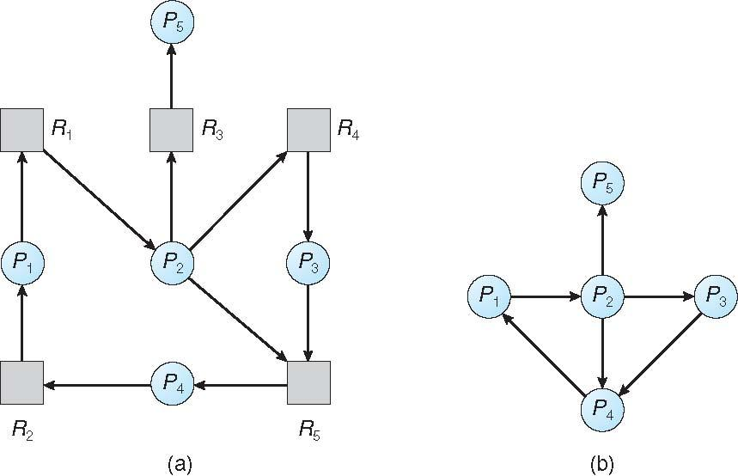
Resource-Allocation Graph and Wait-for Graph
Resource-Allocation Graph
Corresponding
wait-for graph

Slide 130
Several Instances of a Resource Type
Available: A vector of length m indicates the number of available resources of each type.
Allocation: An n x m matrix defines the number of resources currently allocated.
Request: An n x m matrix indicates the current request of each process. If Request [i][j] = k, then process P_{i} is requesting k more instances of resource type R_{j}.

Slide 131
Detection Algorithm
1.Let Work and Finish be vectors of length m and n, respectively
(a) Work = Available
(b) For i = 1,2, …, n, if Allocation_{i} ≠ 0, then Finish[i] = false;
otherwise, Finish[i] = true
2. Find an index i such that both:
(a) Finish[i] == false
(b) Request_{i} ≤ Work
If no such i exists, go to step 4
3. Work = Work + Allocation_{i} Finish[i] = true go to step 2
4. If Finish[i] == false, for some i, 1 ≤ i ≤ n, then the system is in deadlock state. Moreover, P_{i} is also deadlocked

Slide 132
Example of Detection Algorithm
Five processes P₀ through P₄;
three resource types A (7 instances), B (2 instances), and C (6 instances)
Snapshot at time T₀:
Allocation Request Available
A B C A B C A B C
P₀ 0 1 0 0 0 0 0 0 0
P₁ 2 0 0 2 0 2
P₂ 3 0 3 0 0 0
P₃ 2 1 1 1 0 0
P₄ 0 0 2 0 0 2
Sequence <P₀, P₂, P₃, P₁, P₄> will result in
Finish[i] = true for all i
No Deadlock

Slide 133
Example (Cont.)
P₂ requests an additional instance of type C
Request
A B C
P₀ 0 0 0
P₁ 2 0 2
P₂ 0 0 1
P₃ 1 0 0
P₄ 0 0 2
State of system?
Can reclaim resources held by process P₀, but insufficient resources to fulfill other processes; requests
Deadlock exists, consisting of processes P₁, P₂, P₃, and P₄

Slide 134
Recovery from Deadlock
1. Process Termination
Abort all deadlocked processes
Abort one process at a time until the deadlock cycle is eliminated
In which order should we choose to abort?
Priority of the process
How long process has computed, and how much longer to completion
Resources the process has used
Resources process needs to complete
How many processes will need to be terminated
Is process interactive or batch?

Slide 135
Recovery from Deadlock – Contd…
2. Resource Preemption
Selecting a victim – which resource or which process to be preempted? minimize cost
Rollback – return to some safe state, restart process for that state ie. Rollback the process as far as necessary to break the deadlock.
Problem: starvation – same process may always be picked as victim, include number of rollback in cost factor
Ensure that process can be picked as a victim only finite number of times.

Slide 136
References
Refer silberschatz, galvin “ operating system concepts” 9th edition
CPU scheduling and policies – pg no:201-216
Realtime and deadline –pg no: 223 to 230
Process synchronization- pg no:253-275
Deadlocks –pg no:311-334
( Can also refer to learning resources mentioned in the syllabus )

